Slide 1

Affordable nourishment
An analysis of food price fluctuation
Shacham Rotem | Esther Velasco
Notes:
Hi all!
My colleague Sacham and I are very happy to be here with you, and to have the opportunity to talk to you about what we do.

Slide 2
Donating is overwhelming.
Notes:
Let us start with a simple question: do you donate or have you ever donated to any stakeholder taking action against any of our long list world problems?
[Silence.]
Any hands up?

Slide 3

Which problem to prioritise?
Though which organization?
Which country?

Slide 4
Any contribution does make a difference.
Notes:
To better tackle world problems there is a need of understanding the scale to redirect aid better.

Slide 5
We help stakeholders understand
At DEVATA we are on a mission to use the power of data to provide insights on major world problems.
Our goal is to help stakeholders understand where the needs are worldwide to provide a better focus to their decision-making, investments and support.
Notes:
At DEVATA we help all stakeholders understand the scale of world problems through data, approaching the individual to the scale of the issue.

Slide 6

Notes:
On this project we focus on food price fluctuation over time to better understand how it may impact nutrition.

Slide 7
How did we do it?
Notes:
How we make it possible?

Slide 8

Process
Notes:
How we make it possible?

Slide 9
Process
Our dataset
Merging
Cleaning a bit more
Global Food Prices
World Bank: Official exchange rate (LCU per US$)
Exchange rates table
Cleaning / transforming
Analyse and first visuals
Notes:
Our dataset:
Over 740k rows of prices obtained in developing world markets for various goods. Data includes information on country, market, price of good in local currency, quantity of good, and month recorded.
Cleaning & Transforming

Slide 10
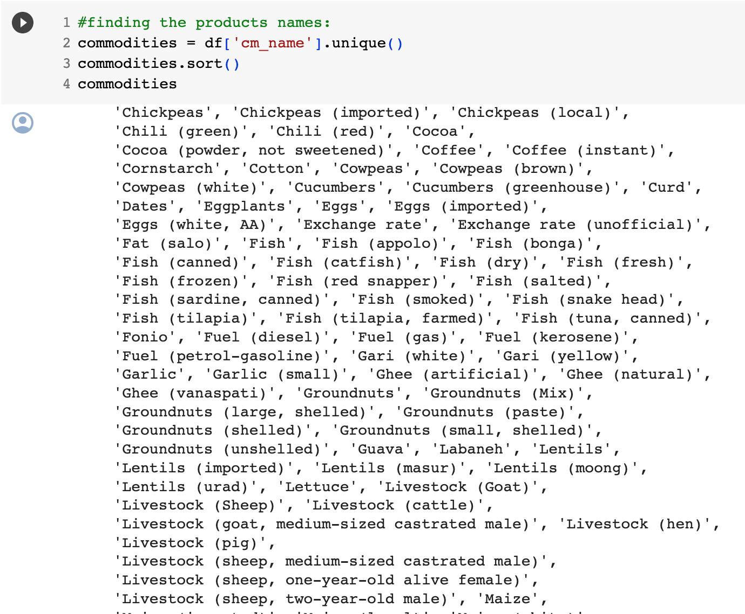
Process
Our dataset
Merging
Cleaning a bit more
Global Food Prices
World Bank: Official exchange rate (LCU per US$)
USD price calculation
Cleaning / transforming
Analyse and first visuals
Write something
write something
keep scrollin´
Notes:
Cleaning was quite extensive given the dimensions of the dataset.

Slide 11
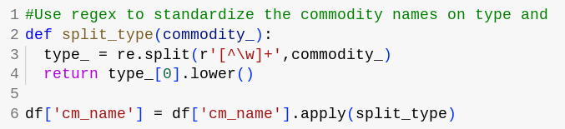
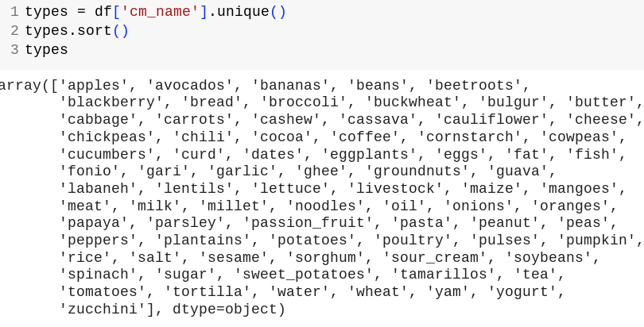
Merging
Notes:
Cleaning was quite extensive given the dimensions of the dataset.

Slide 12
Process
Our dataset
Merging
Cleaning a bit more
Global Food Prices (Kaggle)
World Bank: Official exchange rate (LCU per US$)
Exchange rates table
Cleaning / transforming
Analyse and first visuals
Notes:
But after the cleaning, we could merge:

Slide 13
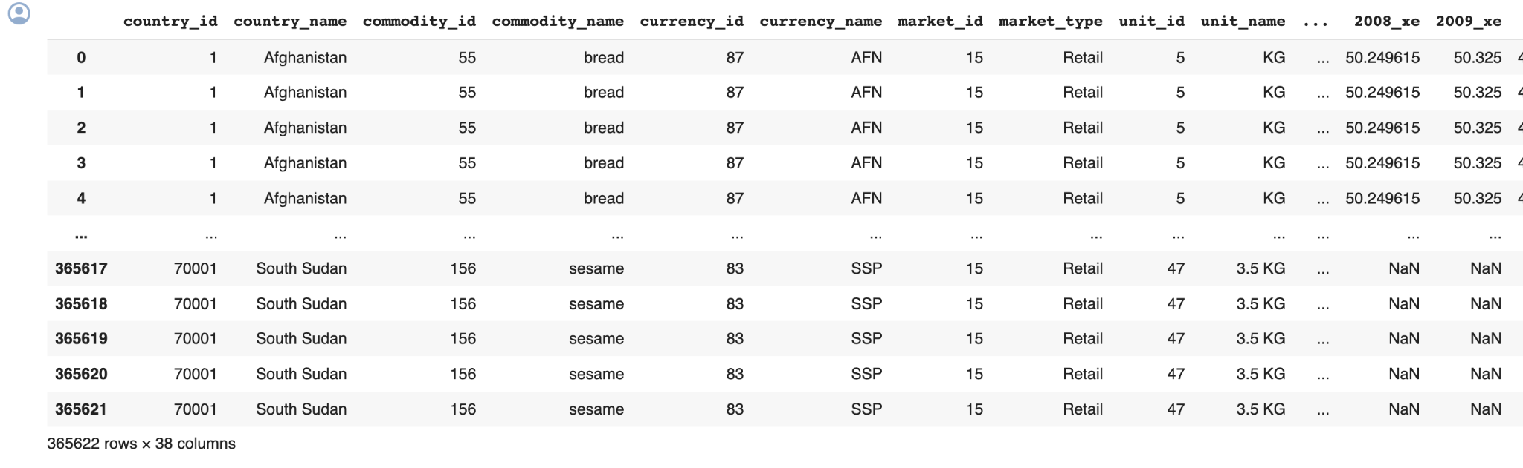
Process
Our dataset
Merging
Cleaning a bit more
Global Food Prices
World Bank: Official exchange rate (LCU per US$)
USD price calculation
Write someth
Cleaning / transforming
Analyse and first visuals
Notes:
Having the country column in common, making some adjustments, we merged the exchange rates, to be able to convert all local prices in dollars for comparison pourposes.

Slide 14
Process
Our dataset
Merging
Cleaning a bit more
Global Food Prices
World Bank: Official exchange rate (LCU per US$)
Exchange rates table
Cleaning / transforming
Analyse and first visuals
Notes:
Then we could analyse/ first plots.

Slide 15
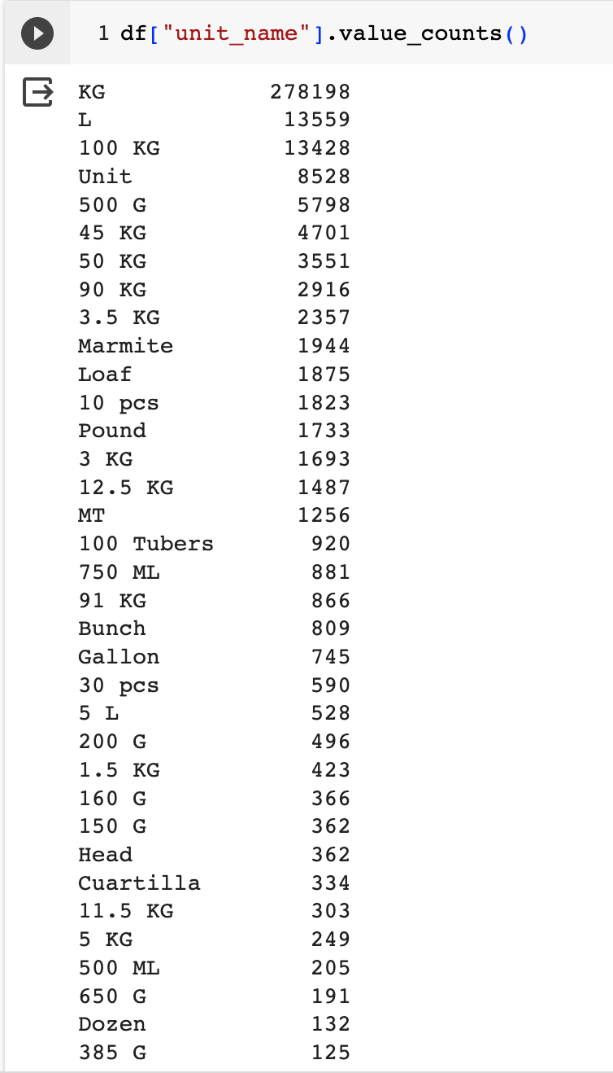
Process
Our dataset
Merging
Cleaning a bit more
!!!!!!!
Global Food Prices
World Bank: Official exchange rate (LCU per US$)
Exchange rates table
megatone?
really!?!
Cleaning / transforming
Analyse and first visuals
Notes:
But some more cleaning got on the way…
But that is the beauty of datacleaning, right?

Slide 16
Process
Our dataset
Merging
Cleaning a bit more
Global Food Prices
World Bank: Official exchange rate (LCU per US$)
Exchange rates table
Cleaning / transforming
Analyse and first visuals
Notes:
Finally we could jump to final visuals and insights.

Slide 17

2. Challenges

Slide 18
Challenges
Cleaning is time consuming and it is better to do all at once.
Topic: understanding of the technical aspects of price fluctuation/ macroeconomics.
How to shape our analysis for relevant insights?
Calculating the USD price with the exchange rate!
Notes:
We found challenges along the way.

Slide 19
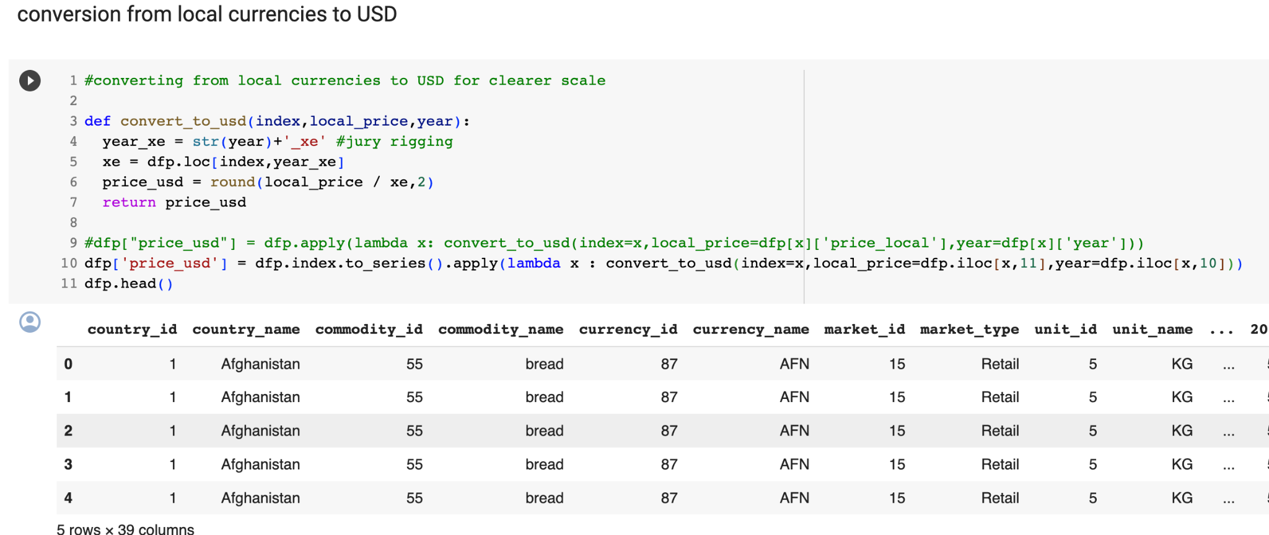
Challenges
Notes:
We found challenges along the way.

Slide 20

3. Insights
Notes:
How we make it possible?

Slide 21
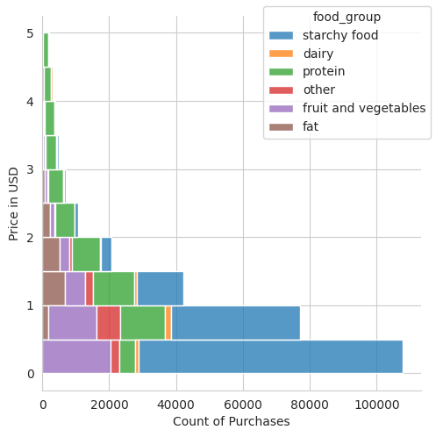
Insights
Most of the purchases in the data set are under the value of one USD.
A large number of them were the purchase of starchy foods like bread, rice and potatoes.
Notes:
We found that most of the purchases in the data set are under the value of one USD.
A large number of them were the purchase of starchy foods like bread, rice and potatoes.

Slide 22
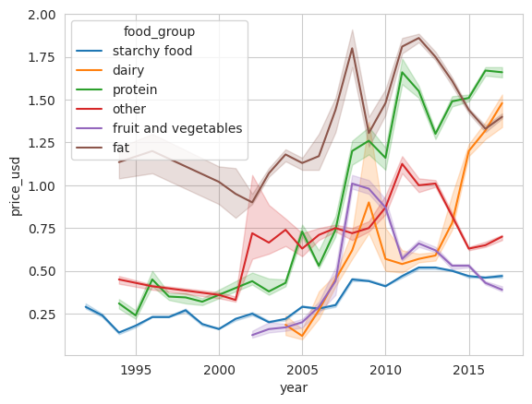
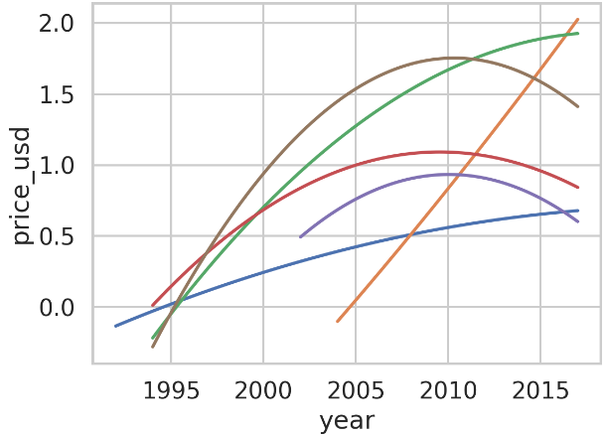
Insights
Notes:
Food price fluctuations can point to instability and food insecurity.
Both dairy and the basic starchy foods prices have an upward trend.

Slide 23
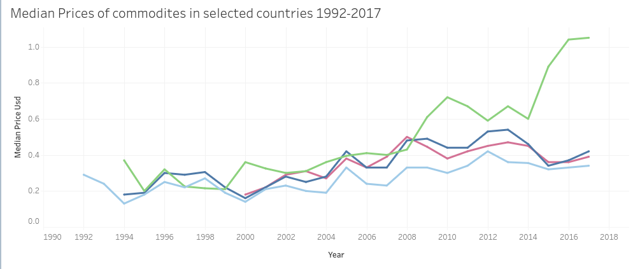
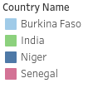
Insights
Notes:
Food prices generally follow GDP growth, mismatch the population can be a sign of financial troubles and even hunger.

Slide 24
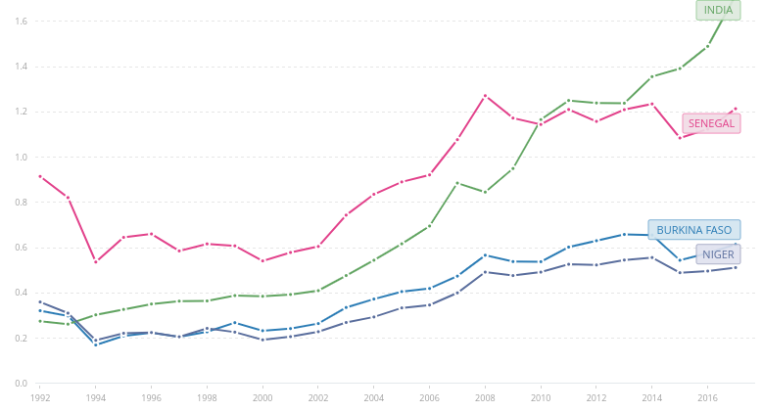

Insights
Adjusted net national income per capita (current US$) - Burkina Faso, India, Niger, Senegal
Source:
Notes:
We compared data from the World Bank about the net national income to see if food prices follow GDP growth

Slide 25
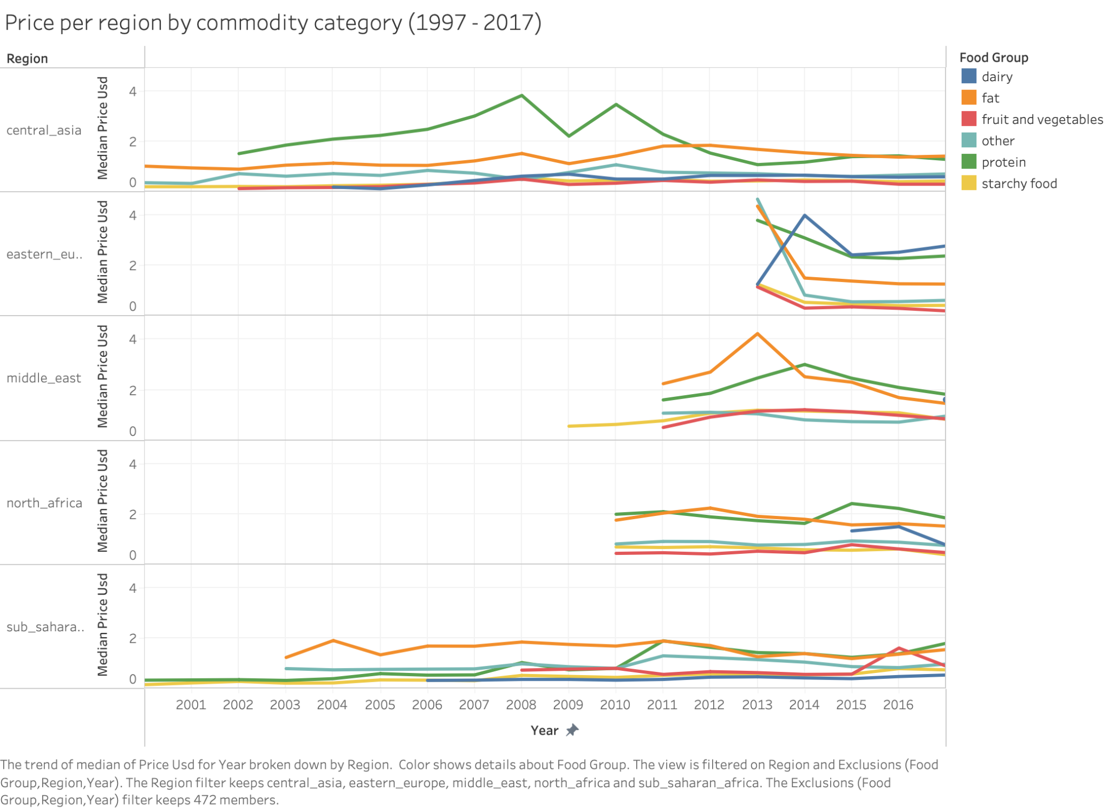
Notes:
Here we can see how in most regions the most expensive food products are protein (mostly beans, chickpeas and derivatives) together with fat.
These are essential for a healthy and complete diet, since ¼ of each of the three recommended intakes a day must contain protein of quality.
Same applied to fat products: good quality fats like avocado, peanuts or non-refined oils are essential for a balanced diet.
It is understood that lower income individuals lack those nutrients greatly, and compensate with diets filled with starchy foods and vegetables.
Public authorities are recommended to focus their policy support on the two categories named above.

Slide 26
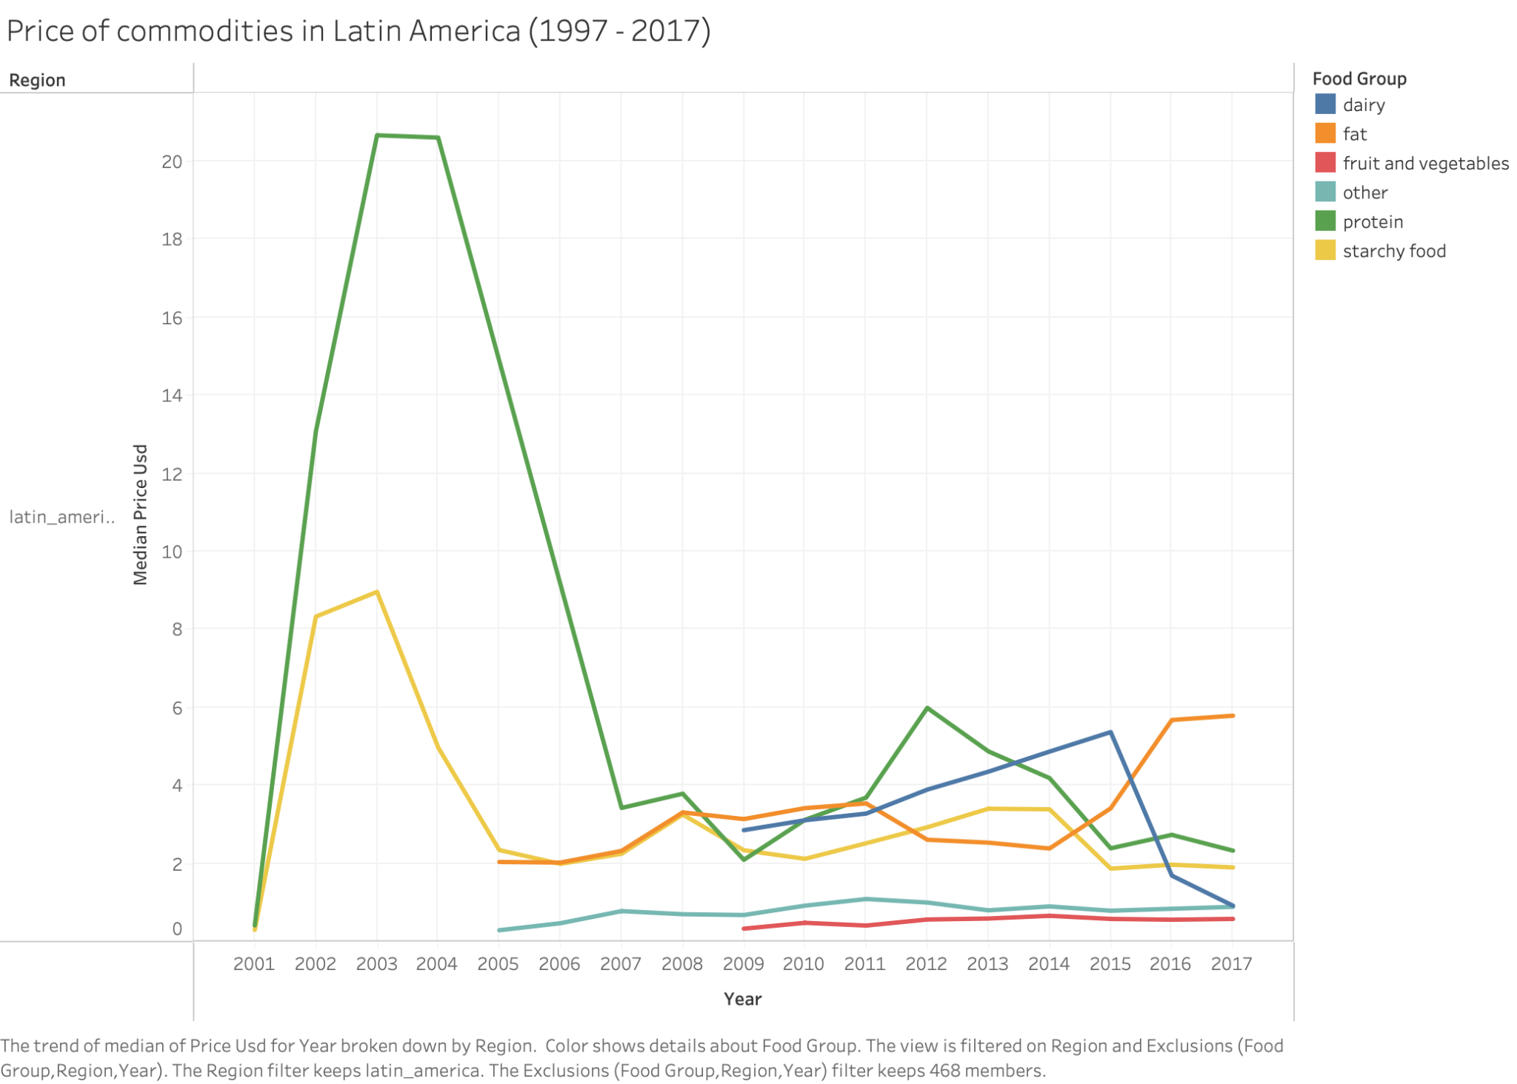
Notes:
In latin america we can identify a peak in the price of protein and starchy food in 2001 until 2005 - 2007.
Before jumping into conclusions, something must have happened in the

Slide 27

4. Lessons and next steps
Notes:
How we make it possible?

Slide 28
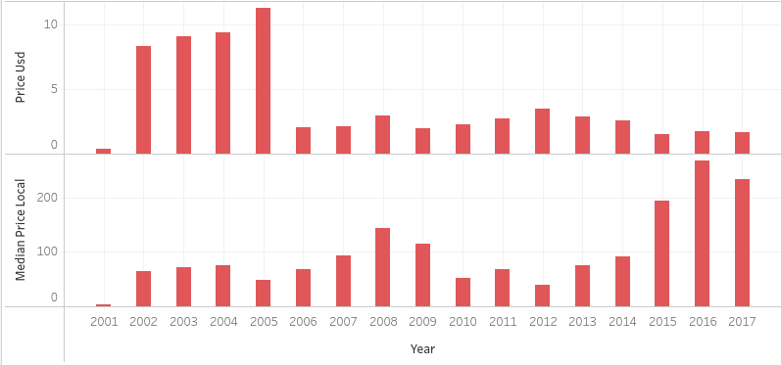

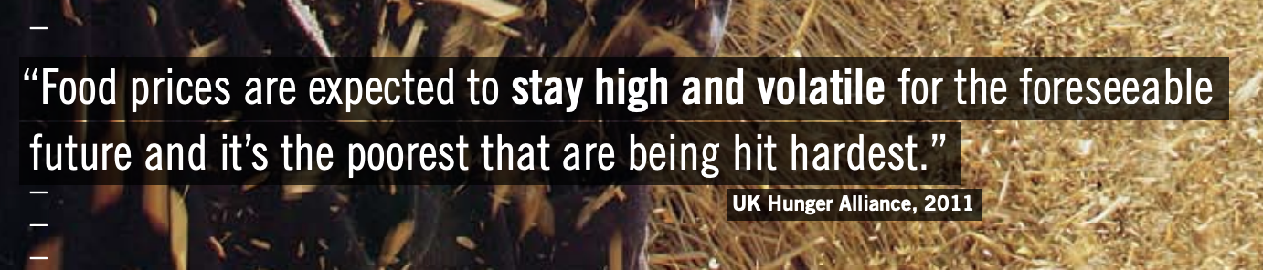
Lessons and next steps
Data aggregation can be misleading.
Food prices increased with growth per capita.
Study individual affordability via a daily food-basket price and compare it with wages over time.
Notes:
Considering the context before jumping into conclusions is essential to do not jump into misleading conclusions. Recommend digging deeper on the causes of these extreme values.
Data normalization for further analysis.
Also, the findings suggest that food prices increased over time together with GDP per capita. We cannot say that food got more affordable yet, since food prices might have increased proportionally with the country's growth.
It is suggested the creation of a daily food basket, per country over time, and compare it with the wages to see the real capacity of individuals to afford a daily meal basket and approach potential donors to the problem.

Slide 29
Any contribution does make a difference.
Notes:
Because remember, any contribution, does make a difference!

Slide 30
¡Thank you!
¿Any questions?
bestanalystsintheworld@devata.com
+91 620 421 838
devata.com
Shacham Rotem
Esther Velasco

